Slide 1
Network Layer :
Internet Protocol
20.<number>
Copyright © The McGraw-Hill Companies, Inc. Permission required for reproduction or display.

Slide 2

OUTLINE
Subnet wrto router perspective
Forwarding mechanism – Routing Table
Address Aggregation
Network Address Translation
IPv6 Addressing
Transition from IPv4 to IPv6

Slide 3

Subnetting – Ex 2
Organization Block 17.12.14.0/26
3 offices – to divide sub-blocks
  1st office – 32 address
  2nd office – 16 address
  3rd office – 16 address

Slide 4

Subnetting – Ex 2
Organization Block 17.12.14.0/26
  64 address
3 offices – to divide sub-blocks
  1st office – 32 address
  2nd office – 16 address
  3rd office – 16 address
/n = 26, /n1 = 27 , /n2=28, /n3=28

Slide 5

Figure 19.8 Three-level hierarchy in an IPv4 address
19.<number>

Slide 6

Figure 19.7 Configuration and addresses in a subnetted network
19.<number>

Slide 7

Internet – Connectionless Packet Switching Inter-Network
Packets in IPv4 called Datagrams
Communication at network layer connectionless
  Resource allocation on demand
  No reserved bandwidth on links, no scheduled processing time for each packet. Ex : Restaurant
N/W Layer protocol treats each packet independently
No relationship between packets
May/May not travel same path to destination
Datagrams could arrive out of order

Slide 8

N/W Layer : Direct vs Indirect Delivery
N/W Layer
  supervises handling of packets by underlying physical networks
  Data Delivery to final destination
  Direct
    Same physical network (SA & DA) (or)
    Delivery between Last router and destination host
    Sender extracts Network Address of Destination Address using mask and compares with directly connected network address
  Indirect
    Not on same network as deliverer
    Packet goes from Router to Router until reaches destination network

Slide 9

Figure 22.1 Direct and indirect delivery
22.<number>

Slide 10
N/W Layer : Forwarding Techniques
Forwarding requires
  Host or Router to have routing table
  Look for a route to destination
  Table lookup vs number of entries
Techniques
  Next Hop Method vs Route Method
    Only Next Hop Address vs Complete Route
  Network-specific vs Host Specific
    Reduce Routing table
    One single entity for same physical network
  Default Method
    Simplify routing

Slide 11

Figure 22.2 Route method versus next-hop method
22.<number>

Slide 12

Figure 22.3 Host-specific versus network-specific method
22.<number>

Slide 13

Figure 22.4 Default method
Host A connected
via 2 networks
22.<number>

Slide 14
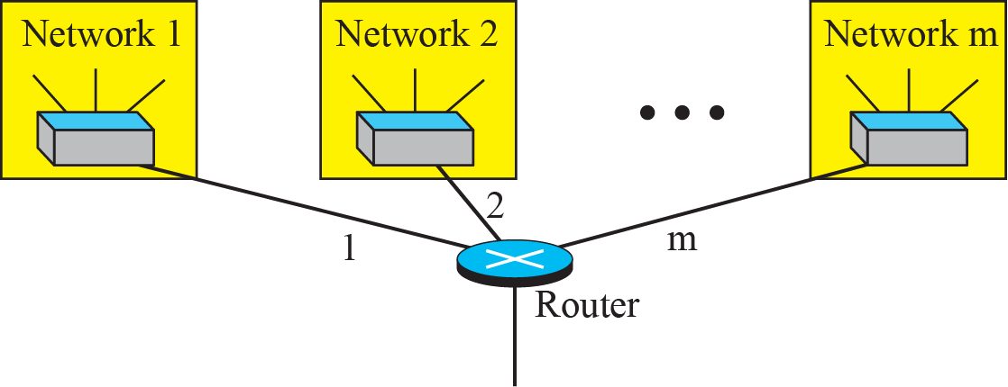
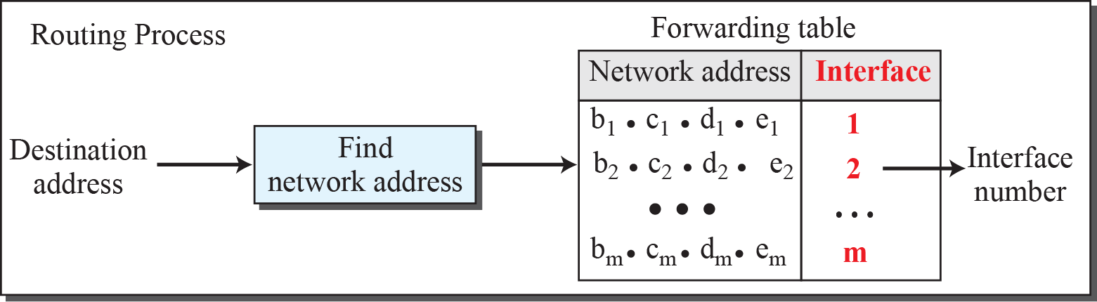
Figure 18.22: Network address
18.<number>
Notes:
18.#

Slide 15
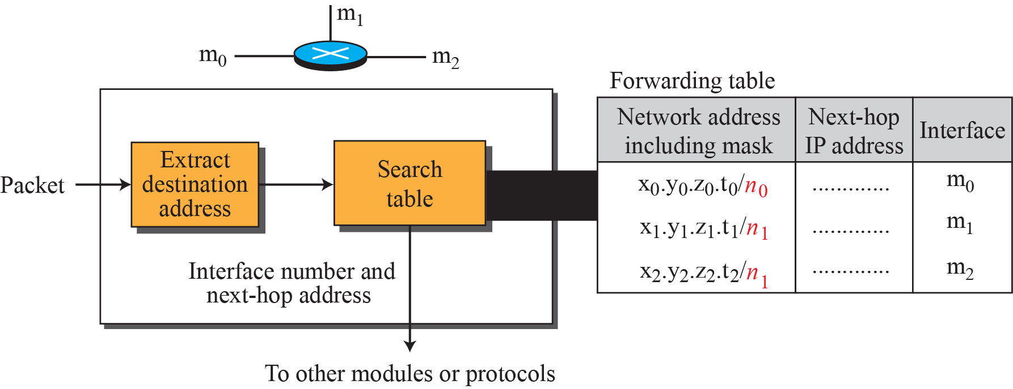
Figure 18.32: Simplified forwarding module in classless address
18.<number>
Notes:
18.#

Slide 16

Figure 22.5 Simplified forwarding module in classless address
In classless addressing, we need at least four columns in a routing table.
22.<number>

Slide 17

Note
In classless addressing, we need at least four columns in a routing table.
22.<number>

Slide 18
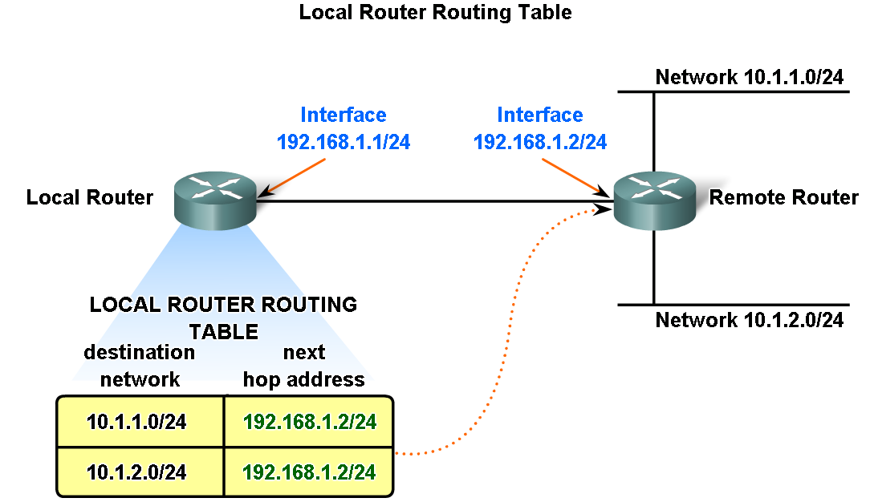
Fundamentals of Routes, Next Hop Addresses and Packet Forwarding

Slide 19
Fundamentals of Routes, Next Hop Addresses and Packet Forwarding

Slide 20
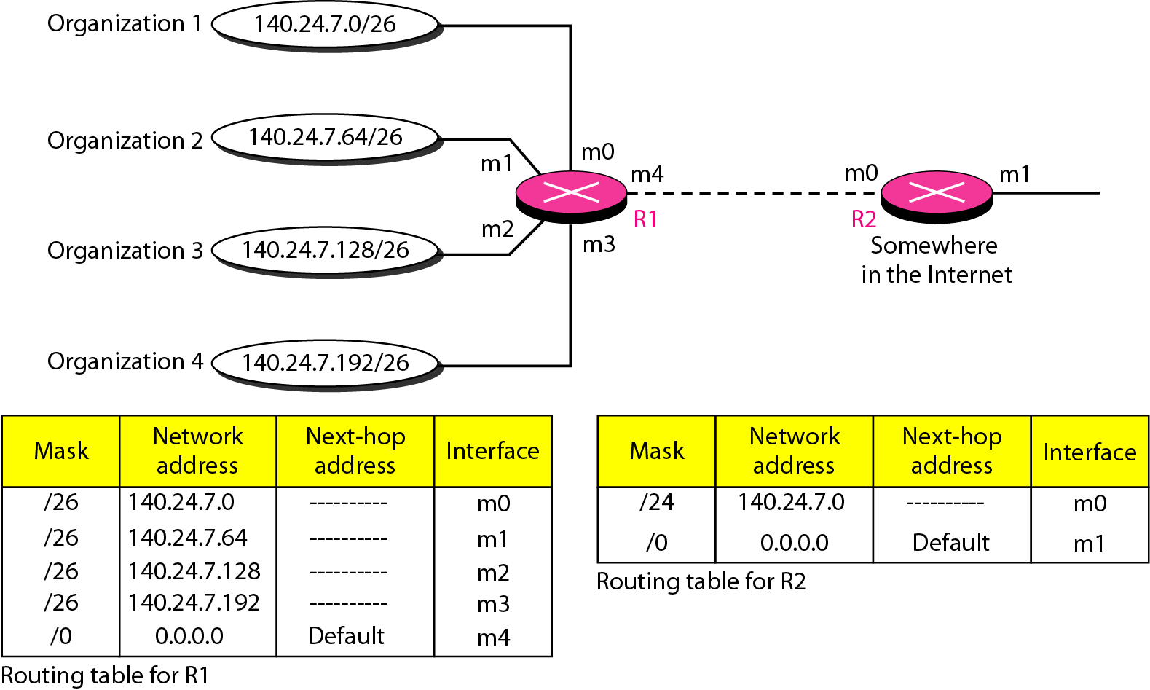
Figure 22.7 Address aggregation
Obtain Network Address from
Destination Address using Mask
22.<number>

Slide 21
Figure 22.7 Address aggregation
Obtain Network Address from
Destination Address using Mask
22.<number>

Slide 22
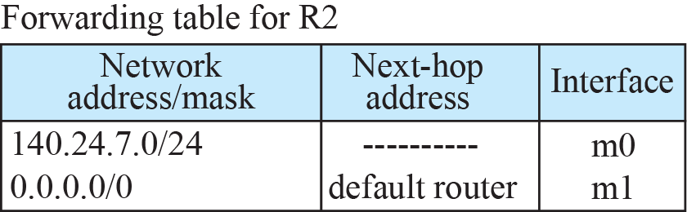
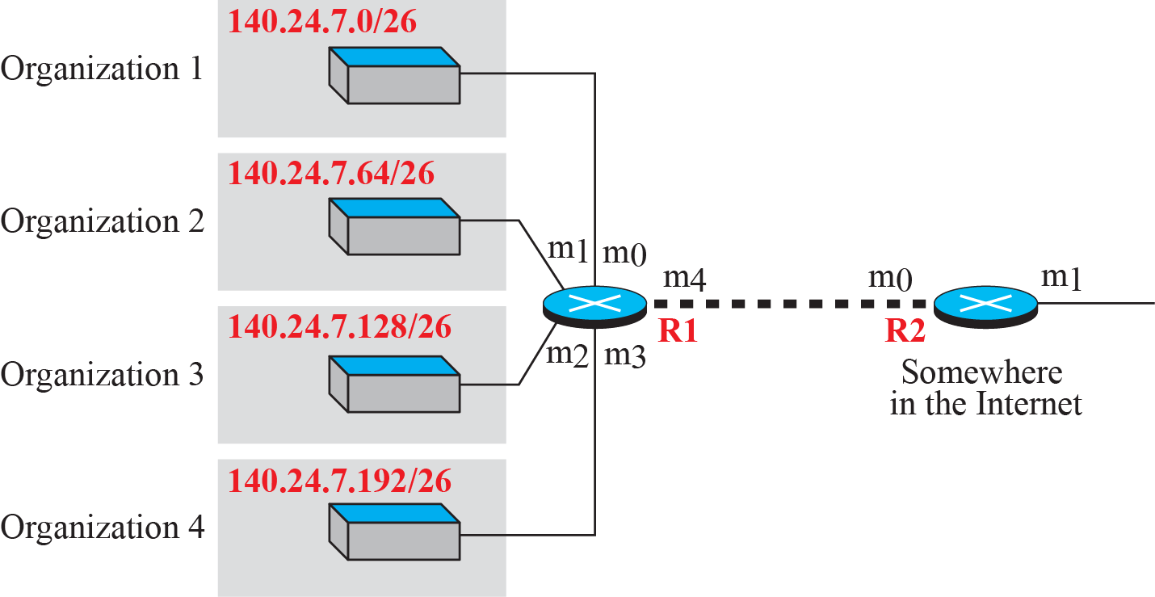


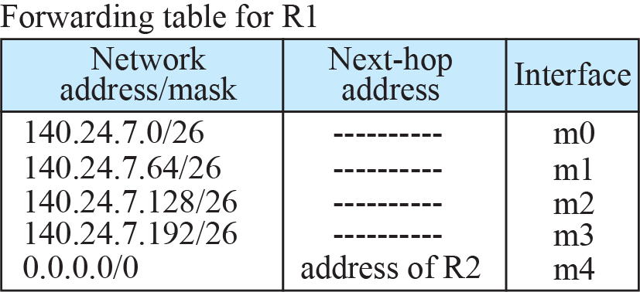
Figure 18.34: Address aggregation
18.<number>
Notes:
18.#

Slide 23
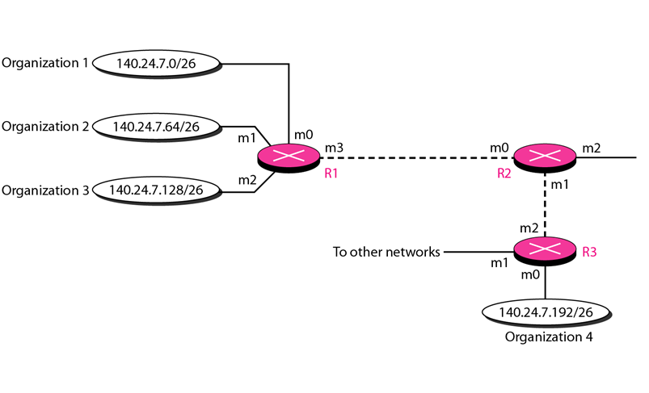
Figure 22.8 Longest mask matching
22.<number>

Slide 24
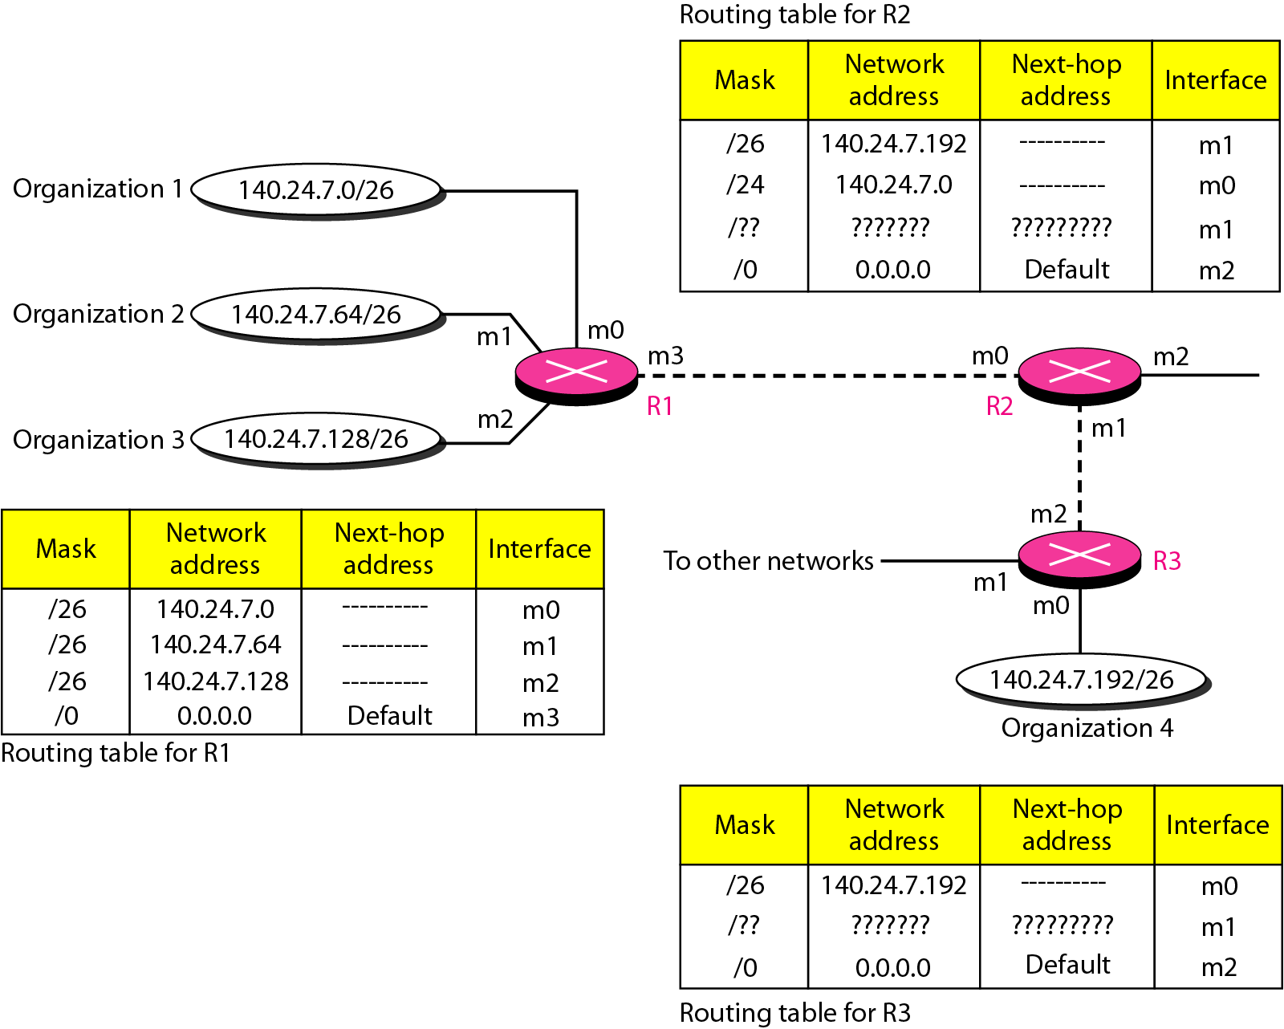
Figure 22.8 Longest mask matching
22.<number>

Slide 25

Network Address Translation (NAT)
Quicker Solution to shortage of addresses
  Separation of address used inside home/business & in Internet
NAT Enables to users to have
  Many to few (one) address mapping
  Large set of address internally
    Traffic inside uses large set
  Small set of address externally
    Traffic outside use small set

Slide 26

Network Address Translation (NAT) contd..
Internet Authorities reserved 3 sets of addresses as private addresses
  No permission needed to use these address
  Reserved for private networks
  Not unique globally but unique inside organization
Table 19.3 Addresses for private networks

Slide 27

Figure 19.10 A NAT implementation
Site must have one single connection to global internet through router
that runs NAT software
The rest of internet sees only the NAT router with address 200.24.5.8
19.<number>

Slide 28

Figure 19.11 Addresses in a NAT
All outgoing packets go thro NAT router , replaces SA with Global NAT
All Incoming packets pass thro NAT router, replaces DA with private Address
How NAT router know DA for packet coming from Internet?
19.<number>

Slide 29

Figure 19.12 NAT address translation – Using One IP address
Destination address of packet (public ip)
19.<number>
Private network needs to initiate communication

Slide 30
Network Address Translation (NAT) contd..
Translation Table
  Using One IP address
    Only 1 private network host can access the same external host
  Using Pool of IP Address
    Say NAT router uses 4 addresses, 4 private network hosts to same external host at same time (restriction)
    No private network host can access two external server programs (HTTP/FTP) at same time
  Using Both IP Addresses and Port Numbers
    To allow many to many relationship between private network hosts and external server programs, more information needed in Translation table..

Slide 31

Table 19.4 Five-column translation table
19.<number>

Slide 32

Figure 19.13 An ISP and NAT
19.<number>

Slide 33

IPv6 (Internetworking Protocol, next generation IPng)
Short term solutions
  Subnetting
  Classless Addressing
  NAT
Address Depletion is still long term problem in Internet
Better security than IPv4 for encryption/authentication of transmitted data
Real time audio/video with reservation of resources, min delay strategies not provided in IPv4

Slide 34
Note
An IPv6 address is 128 bits long.
2⁹⁶ Increase in address space w.r.to IPv4
3.4 x 10³⁸ possible addresses
19.<number>

Slide 35


Figure 19.14 IPv6 address in binary and hexadecimal colon notation
8 sections each 2 bytes = 16 octets
32 hex digits , colon separator (4)
19.<number>

Slide 36


Figure 19.15 Abbreviated IPv6 addresses
Leading zeros can be omitted
Removal zeros and replace with :: (only once even if multiple runs )
19.<number>

Slide 37

Example 19.11
Expand the address 0:15::1:12:1213 to its original.
Solution
We first need to align the left side of the double colon to the left of the original pattern and the right side of the double colon to the right of the original pattern to find how many 0s we need to replace the double colon.
This means that the original address is.
19.<number>

Slide 38
20-4 TRANSITION FROM IPv4 TO IPv6
Because of the huge number of systems on the Internet, the transition from IPv4 to IPv6 cannot happen suddenly. It takes a considerable amount of time before every system in the Internet can move from IPv4 to IPv6. The transition must be smooth to prevent any problems between IPv4 and IPv6 systems.
Topics discussed in this section:
Dual Stack
Tunneling
Header Translation
20.<number>

Slide 39

Figure 20.18 Three transition strategies
20.<number>

Slide 40

Figure 20.19 Dual stack
Recommended approach
Station run IPv4 & IPv6 simultaneously
Source Host Queries DNS for Destination
20.<number>

Slide 41


Figure 20.20 Tunneling strategy
IPv6 encapsulated inside IPv4 packet
Tunneling - network protocol (the delivery protocol) encapsulates & decapsulates a different payload protocol to carry a payload over an incompatible delivery-network
20.<number>

Slide 42
Tunneling
Strategy used when two computers using IPv6 want to communicate with each other
  and packet must pass through a region that uses IPv4.
To pass through this region, the packet must have an IPv4 address.
So the IPv6 packet is encapsulated in an IPv4 packet when it enters the region, and leaves it’s capsule when exist the region
20.<number>

Slide 43

Figure 20.21 Header translation strategy
Used when majority of internet moved to IPv6
Sender wants to use IPv6 but Rx does not understand
Header format totally changed
20.<number>

Slide 44
Special Purpose Addresses
Unspecified Address 0::0
  Used by source station to learn own address
Loopback Address ::1
IPv4-compatible addresses 96 0’s + IPv4
  for devices that are compatible with both IPv4 and IPv6
  For tunneling by IPv6 routers connected to IPv4 networks
  ::135.150.10.247
IP-mapped addresses: 80 0’s + 16 1’s + IPv4
  Denote IPv4 hosts & routers that do not support IPv6

Slide 45
Routing Table
Routing Table
  Static
    Administrator – manual entries
  Dynamic
    Updated automatically when change somewhere in internet.
    Table updated as soon as there is change
    Ex : Router is down/ better route/ link failure

Slide 46
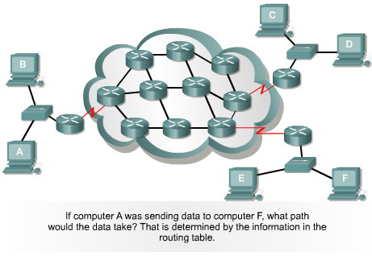
Path Determination Graphic

Slide 47


Routing Protocol
Router
Switch
Router
Router
Router
Switch
Router
What is
an optimal
route ?

